Slide 1
Antarctica The Continent Series
VMS Library 2008-2009

Slide 2
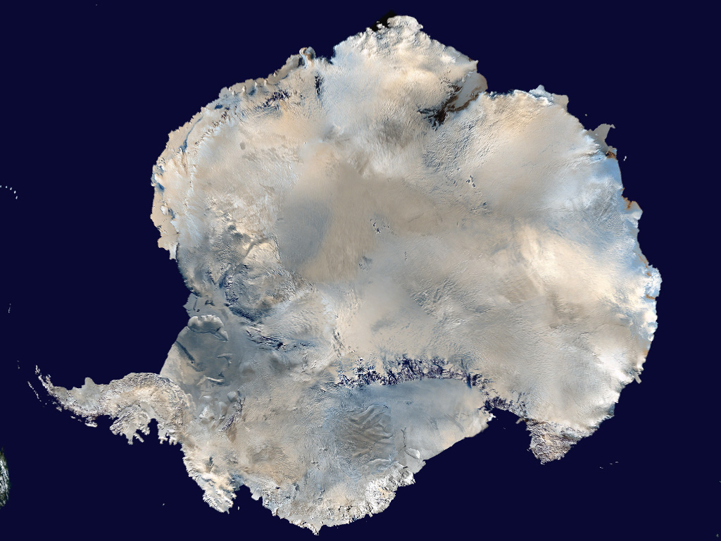
Satellite view

Slide 3
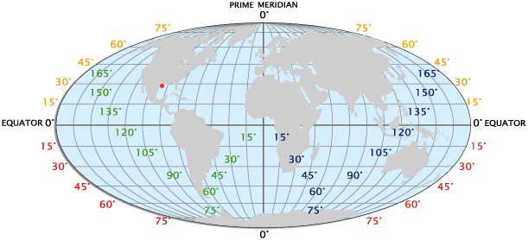
Longitude / Latitude

Slide 4
Interesting stuff
If Antarctica's ice sheets melted, the worlds oceans would rise by 60 to 65 metres (200 - 210ft) - everywhere.
Antarctica is the best place in the world to find meteorites. Dark meteorites show up against the white expanse of ice and snow and don't get covered by vegetation.
One of the biggest icebergs ever (possibly the biggest iceberg ever) broke free from the Ross ice shelf in Antarctica in 2000. {183 miles long and 23 miles wide}

Slide 5
Interesting stuff part 2
It has been estimated that during the feeding season in Antarctica, a full grown blue whale eats about 4 million krill per day (krill are small shrimp-like creatures), that's 4 tons - every day for 6 months.
The lowest ever temperature recorded was at the Russian Vostok station. It was - 89.6°C
The largest land animal in Antarctica is an insect, a wingless midge, Belgica antarctica, less than 1.3cm (0.5in) long.

Slide 6
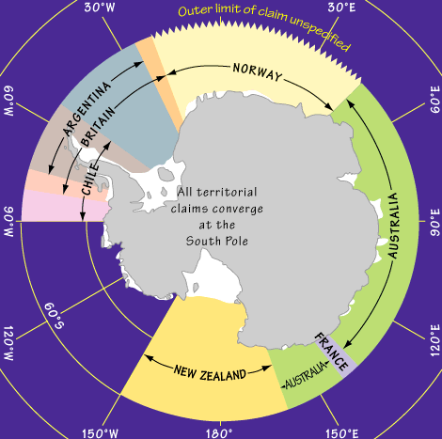
Territorial Water Claims

Slide 7
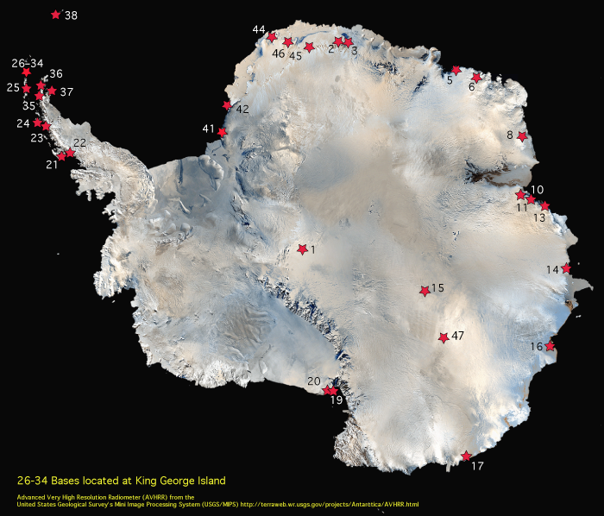
Antarctic Bases
1 Amundsen-Scott United States
2 Maitri India
3 Novolazarevskaya Russia
4 *Marion Island South Africa
5 Syowa Japan
6 Molodezhnaya Russia
7 *Alfred Faure, Iles Crozet France
8 Mawson Australia
9 *Port aux Français, Iles Kerguelen France
10 Zhongshan China
11 Progress Russia
12 *Martin de Viviès, Ile Amsterdam France
13 Davis Australia
14 Mirny Russia
15 Vostok Russia
16 Casey Australia
17 Dumont d’Urville France
18 *Macquarie Island Australia
19 McMurdo United States
20 Scott Base New Zealand
21 Rothera United Kingdom
22 San Martin Argentina
23 Vernadsky Ukraine
24 Palmer United States
25 Capitan Arturo Prat Chile
26 +Presidente Eduardo Frei Chile
27 +Escudero Chile
28 +Great Wall China
29 +Bellingshausen Russia
30 +Artigas Uruguay
31 +King Sejong Korea
32 +Jubany Argentina
33 +Arctowski Poland
34 +Comandante Ferraz Brazil
35 General Bernardo O’Higgins Chile
36 Esperanza Argentina
37 Marambio Argentina
38 Orcadas Argentina
39 *Bird Island United Kingdom
40 *King Edward Point United Kingdom
41 Belgrano II Argentina
42 Halley United Kingdom
43 *Gough Island South Africa
44 Neumayer Germany
45 SANAE South Africa
46 Troll, Norway
47 Concordia, France/Italy
*Stations north of 60°S
USA
#1 Amundsen-Scott
#19 McMurdo
#24 Palmer

Slide 8
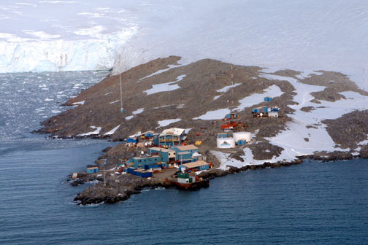
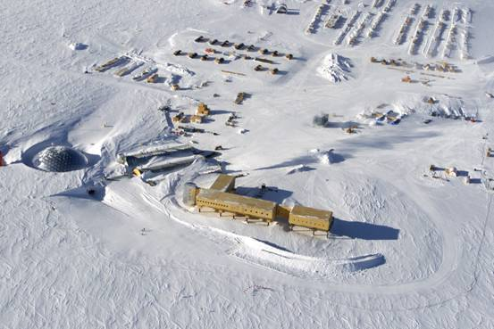
USA Bases
Palmer
Amundsen-Scott South Pole
McMurdo

Slide 9
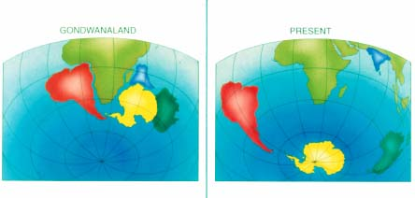
Geology

Slide 10
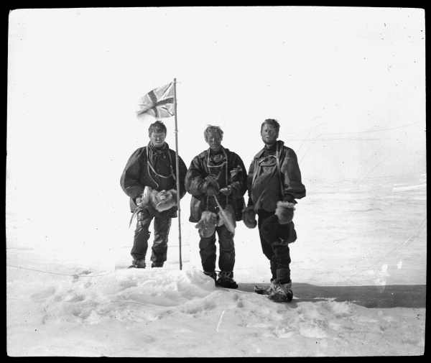
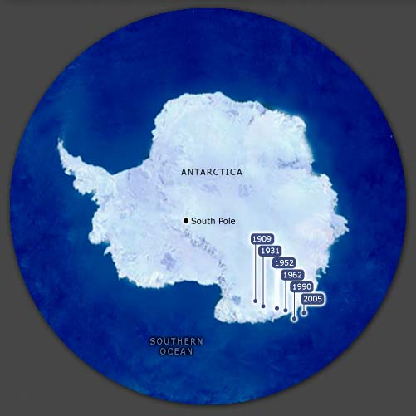
Magnetic South Pole

Slide 11
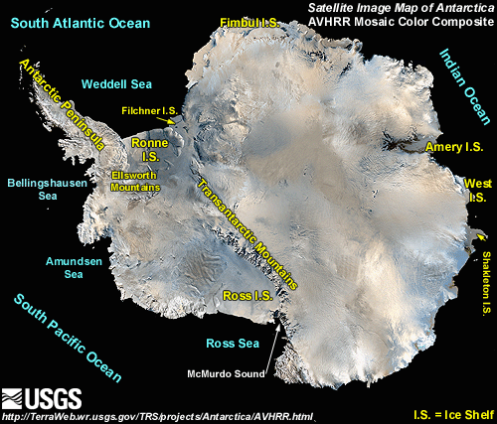
Physical Features

Slide 12
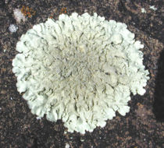
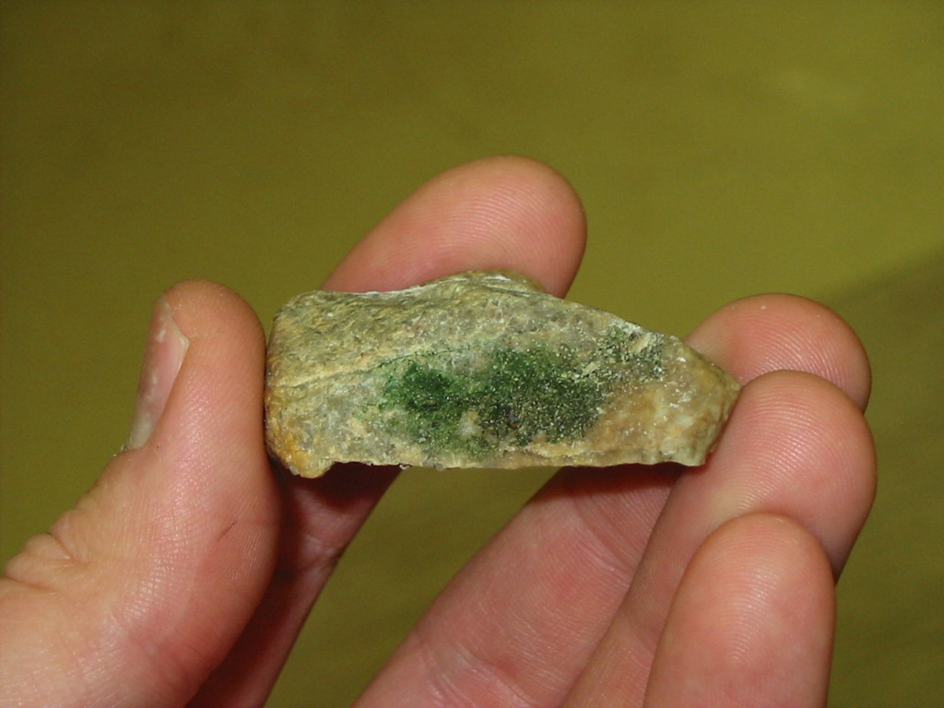
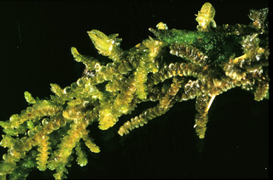
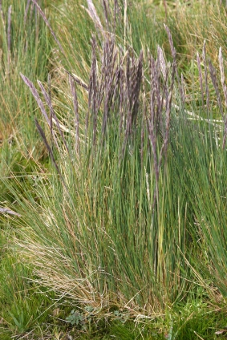
Plant Life
2% of the continent is ice free
150 lichens
30 mosses
One liverwort
Artic Hair grass

Slide 13
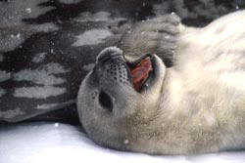
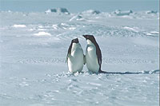
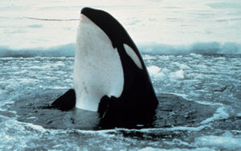
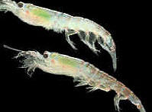
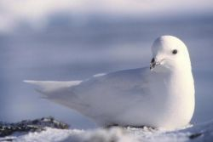
Animal Life
Weddell seals
Live up to 18 years
Blue
Fin
Humpback
Minke
Orca
Sei
Sperm
Adelie penguin
20 inches tall, 12 pounds
Krill
They are 1-6” in length
Snow Petrel
Live 14-20 years

Slide 15
This powerpoint was kindly donated to www.worldofteaching.com
http://www.worldofteaching.com is home to over a thousand powerpoints submitted by teachers. This is a completely free site and requires no registration. Please visit and I hope it will help in your teaching.

